Slide 1
DPDK Optimization Techniques and
Open vSwitch Enhancements for Netdev DPDK
OVS 2015 Summit
Muthurajan Jayakumar
Gerald Rogers

Slide 2
Legal Disclaimer
General Disclaimer:
© Copyright 2015 Intel Corporation. All rights reserved. Intel, the Intel logo, Intel Inside, the Intel Inside logo, Intel. Experience What’s Inside are trademarks of Intel. Corporation in the U.S. and/or other countries. *Other names and brands may be claimed as the property of others.
Technology Disclaimer:
Intel technologies’ features and benefits depend on system configuration and may require enabled hardware, software or service activation. Performance varies depending on system configuration. No computer system can be absolutely secure. Check with your system manufacturer or retailer or learn more at [intel.com].
Performance Disclaimers (include only the relevant ones):
Cost reduction scenarios described are intended as examples of how a given Intel- based product, in the specified circumstances and configurations, may affect future costs and provide cost savings. Circumstances will vary. Intel does not guarantee any costs or cost reduction.
Results have been estimated or simulated using internal Intel analysis or architecture simulation or modeling, and provided to you for informational purposes. Any differences in your system hardware, software or configuration may affect your actual performance.

Slide 3
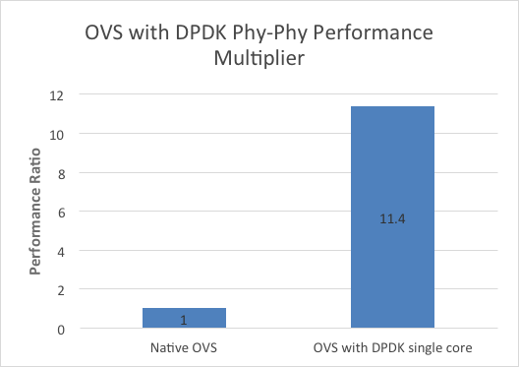
OpenvSwitch 2.4 netdev-DPDK Feature Enhancements
Performance
Phy-Phy with 256 byte packets, OVS with DPDK can achieve >40Gb/s throughput on a single forwarding core*.
Features :
DPDK support up to 2.0
vHost Cuse
vHost User
ODL / Openstack detection
Link bonding
Mini-flow performance
vHost batching
vHost retries
Rx vectorisation
EMC size increase
Performance enhancements
Disclaimer: Software and workloads used in performance tests may have been optimized for performance only on Intel microprocessors. Performance tests, such as SYSmark and MobileMark, are measured using specific computer systems, components, software, operations and functions. Any change to any of those factors may cause the results to vary. You should consult other information and performance tests to assist you in fully evaluating your contemplated purchases, including the performance of that product when combined with other products. E5-2658 (2.1GHz, 8C/16T) DP; PCH: Patsburg; LLC: 20MB; 16 x 10GbE Gen2 x8; 4 memory channels per socket @ 1600MT/s, 8 memory channels total; DPDK 1.3.0-154 E5-2658v2 (2.4GHz, 10C/20T) DP; PCH: Patsburg; LLC: 20MB; 22 x 10GbE Gen2 x8; 4 memory channels per socket @ 1867MT/s, 8 memory channels total; DPDK 1.4.0-22 *Projection data on 2 sockets extrapolated from 1S run on Wildcat Pass system with E5-2699 v3.

Slide 4
OpenvSwitch 2.4
netdev-DPDK Performance Enhancements
VM
VM
DPDK
virtio
shmem
qemu
qemu
Align burst sizes
Enable Vector PMD
ovs-switchd
ovs-switchd
DPDK
Libraries
IVSHEM
vHost
User Space Forwarding
DPDK
netdev
Tunnels
netdev
TAP
socket
PMD
Enable Vector PMD
Increase EMC Cache Size
Fix miniflow bug
Notes:
A lot of cycles prior to 2.4 release to optimize performance.
Key areas are listed.

Slide 5
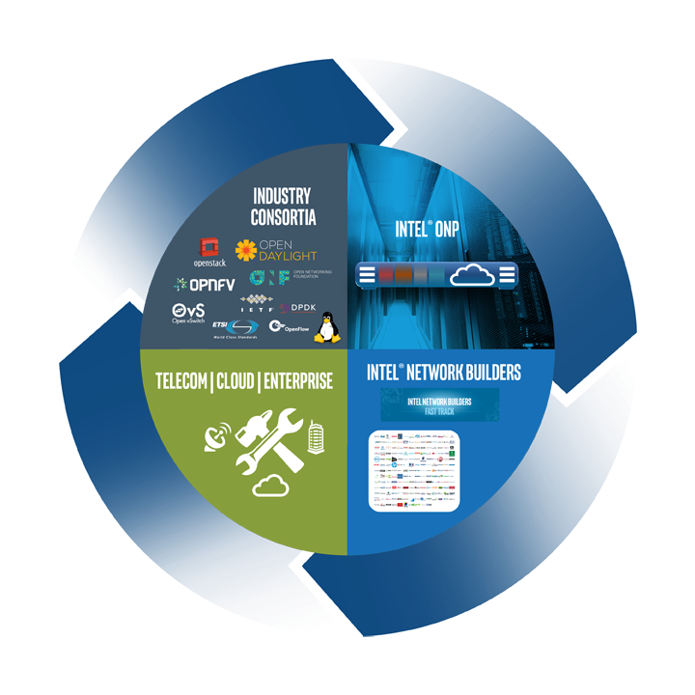
Enable the Transformation
Advance Open Source and Standards
Deliver Open Reference Architecture
Enable Open Ecosystem on IA
Collaborate on Trials and Deployments
https://01.org/packet-processing/intel®-onp-servers
Notes:
Intel influencing the transformation through a 4-part strategy (This is what SDND is all about - SDND Enables the transformation)
4 elements of the strategy feed each other are creating a strong foundation for the industry to leverage on.
Advance Open Source Open Standards
Promote and contribute to industry standards and open source solutions for interoperability
Committed to “Open” standards for a competitive market
2. Deliver Open reference Designs
Leading performance, security, open source software and reference designs
Enable industry leading manageability by exposing health, state, resource availability for optimal workload placement and configuration
3. Enable Open Ecosystem on IA
Enable TEMs/OEMs to deliver industry leading performance, power, cost, security optimized solutions
4. Collaborate on trials and deployments
Building solution experience with leading Enterprise, Telco and Cloud Service Providers and Vendors

Slide 6







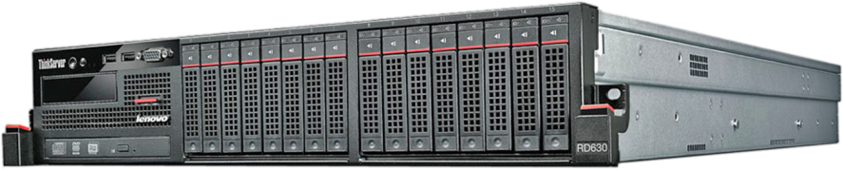

Intel® Open Network Platform (Intel® ONP)
Intel® ONP Software Ingredients Based on
Open Source and Open Standards
What is Intel® ONP
Reference Architecture?*
Reference Architecture that brings
together hardware and open
source software ingredients
Optimized server architecture for SDN/NFV in Telco, Enterprise
and Cloud
Vehicle to drive development and
to showcase solutions for
SDN/NFV based on IA
*Not a commercial product
Industry Standard Server Based
on Intel Architecture
VM
VIRTUAL SWITCH
HW
OFFLOAD
DPDK
LINUX/
KVM

Slide 7
OpenvSwitch 2.4
Platform Performance Configuration
Item | Description
Server Platform | Intel® Server Board S2600WT2 DP (Formerly Wildcat Pass) 2 x 1GbE integrated LAN ports Two processors per platform
Chipset | Intel® C610 series chipset (Formerly Wellsburg)
Processor | Intel® Xeon® Processor E5-2697 v3 (Formerly Haswell) Speed and power: 2.60 GHz, 145 W Cache: 35 MB per processor Cores: 14 cores, 28 hyper-threaded cores per processor for 56 total hyper-threaded cores QPI: 9.6 GT/s Memory types: DDR4-1600/1866/2133, Reference: http://ark.intel.com/products/81059/Intel-Xeon-Processor-E5-2697-v3-35M-Cache-2_60-GHz
Memory | Micron 16 GB 1Rx4 PC4-2133MHz, 16 GB per channel, 8 Channels, 128 GB Total
Local Storage | 500 GB HDD Seagate SATA Barracuda 7200.12 (SN:9VMKQZMT)
PCIe | Port 3a and Port 3c x8
NICs | 2 x Intel® Ethernet CAN X710-DA2 Adapter (Total: 4 x 10GbE ports) (Formerly Fortville)
BIOS | Version: SE5C610.86B.01.01.0008.021120151325 Date: 02/11/2015

Slide 8
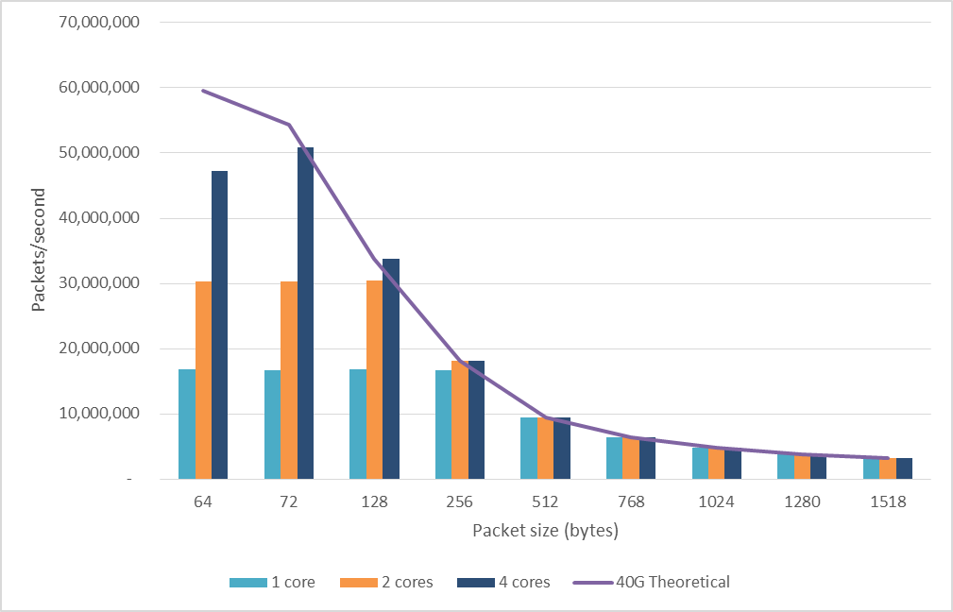
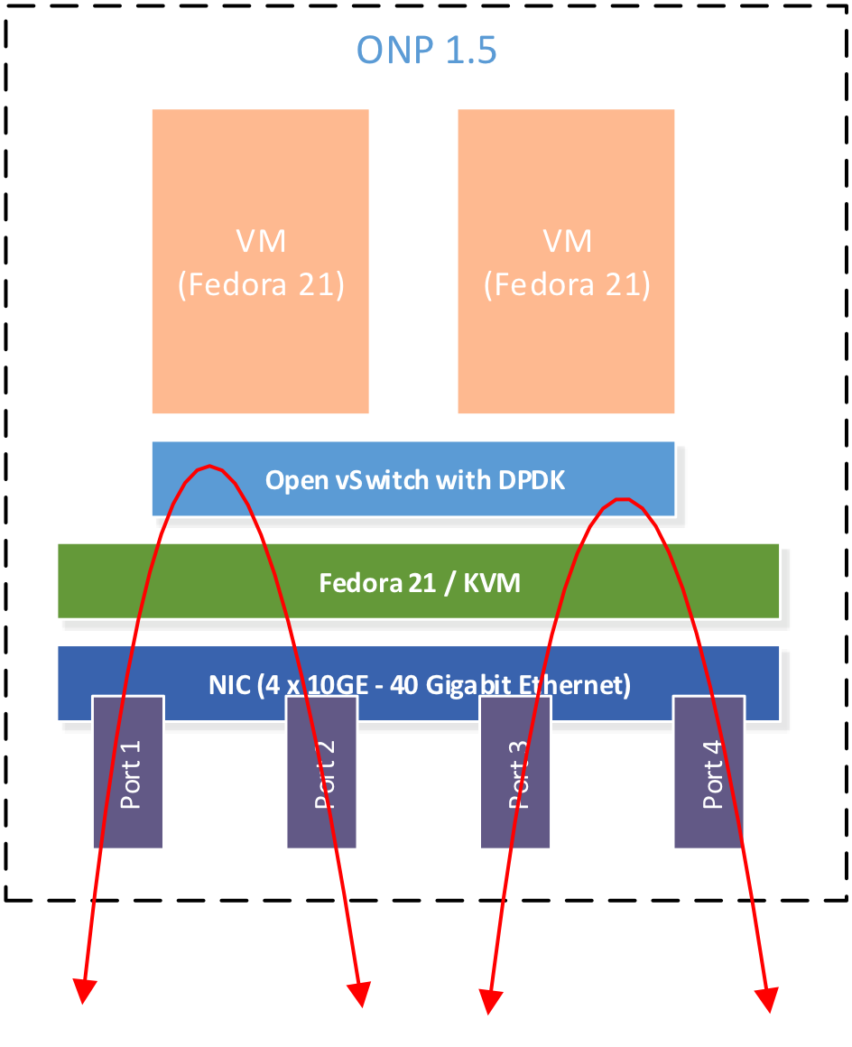
OpenvSwitch 2.4
Phy-OVS-Phy Performance
Disclaimer: For more complete information about performance and benchmark results, visit www.intel.com/benchmarks and https://download.01.org/packet-processing/ONPS1.5/Intel_ONP_Server_Release_1.5_Performance_Test_Report_Rev1.2.pdf

Slide 9
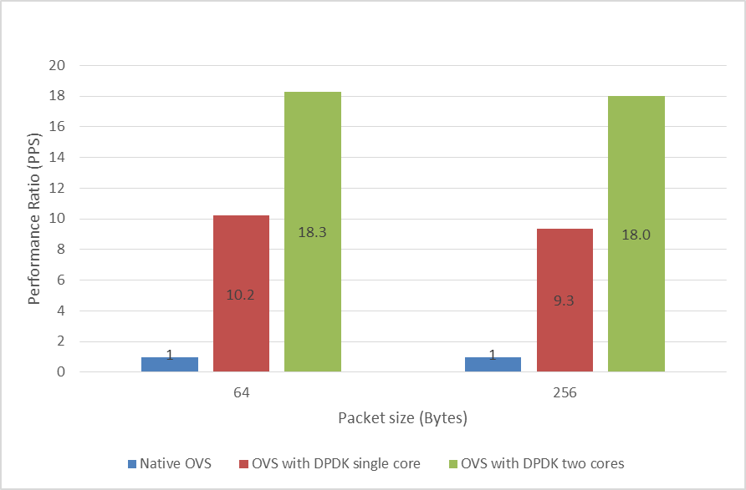
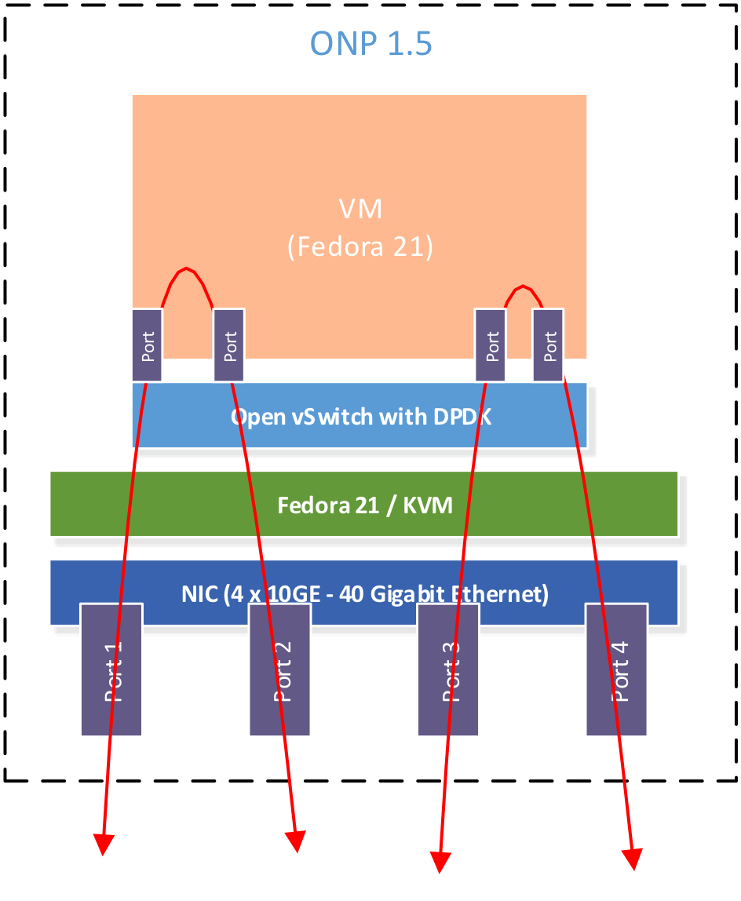
OpenvSwitch 2.4
Phy-VM-Phy Performance
Aggregate Switching Rate
Disclaimer: For more complete information about performance and benchmark results, visit www.intel.com/benchmarks and https://download.01.org/packet-processing/ONPS1.5/Intel_ONP_Server_Release_1.5_Performance_Test_Report_Rev1.2.pdf

Slide 10
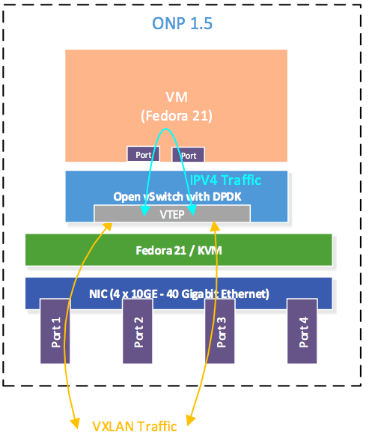
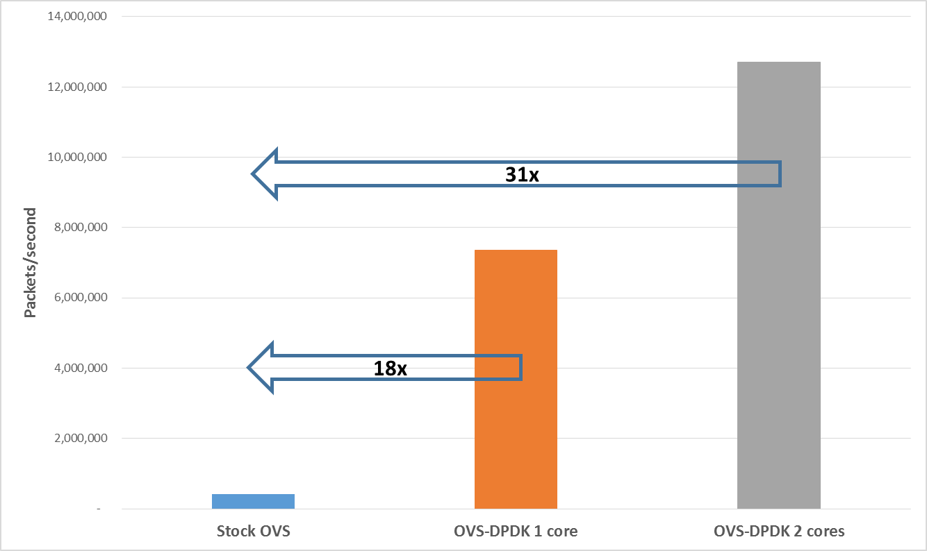
OpenvSwitch 2.4
Phy-OVS Tunnel-Phy Performance
Aggregate Switching Rate
Disclaimer: For more complete information about performance and benchmark results, visit www.intel.com/benchmarks and https://download.01.org/packet-processing/ONPS1.5/Intel_ONP_Server_Release_1.5_Performance_Test_Report_Rev1.2.pdf

Slide 11
OpenvSwitch 2.x DPDK 2.x
netdev-DPDK Performance Enhancements
Vector Tuple Extractor
DPDK Hash
Variable Key Hash
DPDK Patch Port
VM
VM
DPDK
virtio
shmem
qemu
qemu
Virtio ordering
vHost Bulk Alloc
Zero Copy Recieve
Enable Vector PMD
ovs-switchd
ovs-switchd
DPDK
Libraries
IVSHEM
vHost
User Space Forwarding
DPDK
netdev
Tunnels
netdev
TAP
socket
Match
Action
PMD
Accelerator
(e.g. FM10K)
Device Agnostic Match Action Control Interface
Tunnel processing
Notes:
Vector Tuple Extractor – Implements tuple extraction using vector instructions. Masks off the fields vs. retrieve them from the header one at a time.
DPDK Hash – Change to DPDK hash calculation to perform a lookup. Integrate Cuckoo Cuckoo hash
Variable Key Hash – Increase hash to include all fields, reducing table collisions. Hash is variable in length.
DPDK Patch Port – Special port type to enable direct port to port communication.
Tunnel Processing – Reduce the pipeline processing by detecting a vxLan tunnel and perform a single lookup instead of multiple lookups in table.
VirtIO ordering – Modify the guest virtio descriptor tables to pre-arrange the descriptors, reducing processing overhead.
vHost Bulk Allocation – Changes to the vHost backend to use mbuf bulk allocation / deallocation. Reduces lock overheads. Simplify the vHost code in DPDK.
Zero Copy receive – Implment vHost RX to eliminate copies on the receive side. This results in the guest buffer being held until transmitted past the egress port.

Slide 12
DPDK
Multi Architecture
High Performance
Packet Processing
Network Platforms Group – November 2015
Muthurajan Jayakumar

Slide 13

Agenda
DPDK – Multi Architecture Support
Optimizing Cycles per Packet
DPDK – Building Block for OVS/NFV
Enhancing OVS/NFV Infrastructure
Call To Action

Slide 14

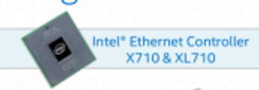
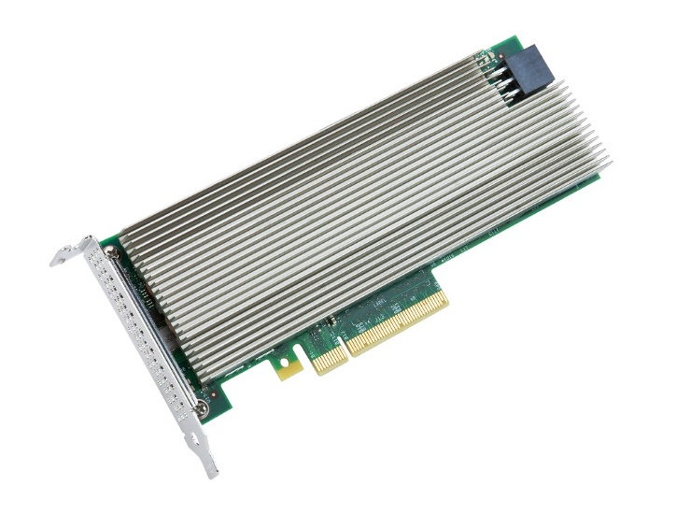





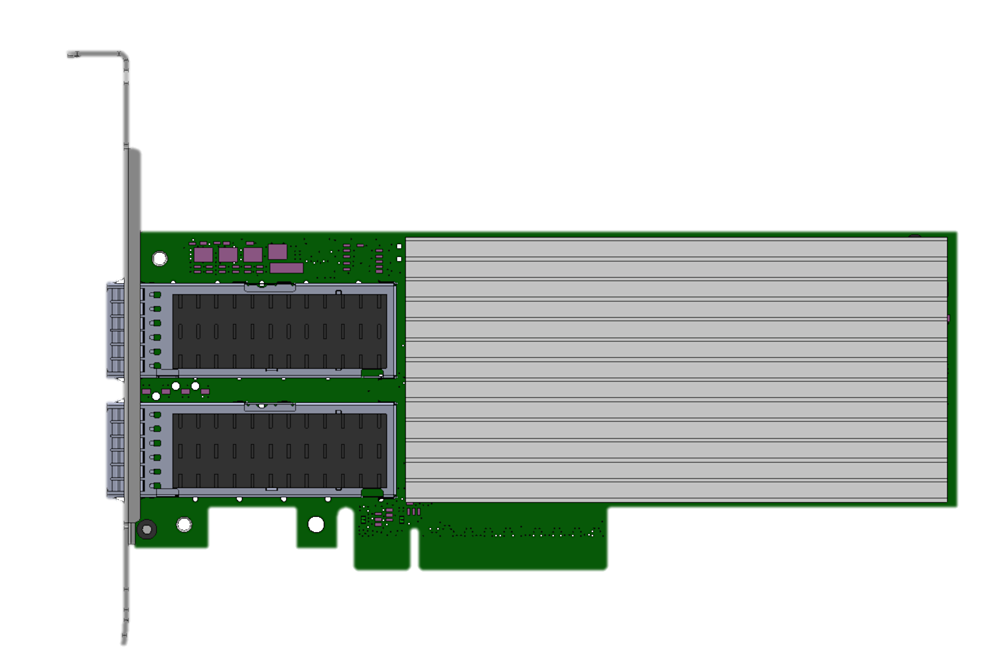
DPDK – Multi Architecture Support
Broadcom*/Qlogic*
40 Gig
NIC
Chelsio*
IBM Power 8
TILE-Gx
ARM v7/v8
CISCO VIC*
Quick Assist
Technology
Emulex*
DPDK 1.8
DPDK 2.0
DPDK 2.1
DPDK 2.2
Mellanox*
FM10000

Slide 15
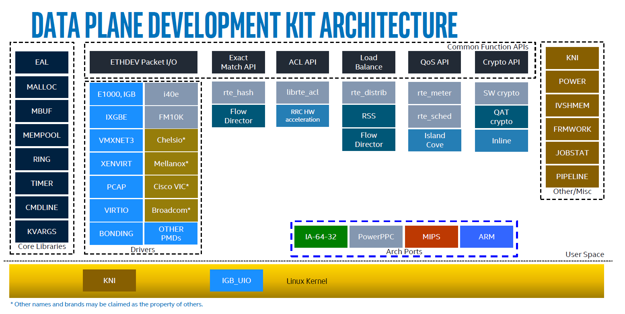
Any Testimonials for Latency & Throughput?

Slide 16
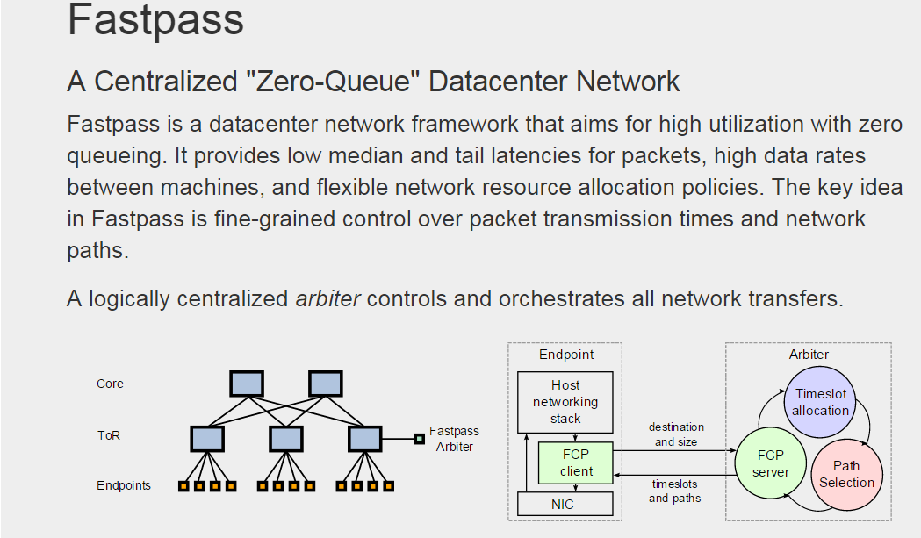
If Optimizing For Throughput, How Is Latency?
MIT* white paper on Fast Pass
Dream of a system with ZERO Queue
Ultimate testimonial for Latency
See How DPDK Can Solve Your Latency Concern http://fastpass.mit.edu

Slide 17
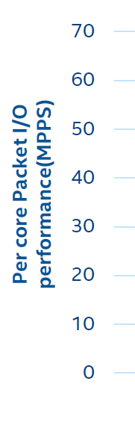
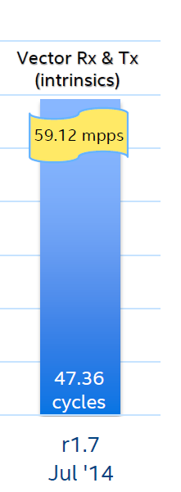
Packet Processing
Input Packet A
Input Packet B
With 2.8 GHz E5-2680v2
Rx Budget = 19 cycles
Tx Budget = 28 cycles
Look up In packet A
Look up In packet B
Do the “Desired” Action
Do the “Desired” Action
Inter Packet Arrival Time
Line Rate | 64 byte packet – Arrival Rate
10 GbE | 67.2 ns
40 GbE | 16.8 ns
100 | 6.7 ns
Rx Budget = 19 cycles.
Tx Budget = 28 cycles.

Slide 18
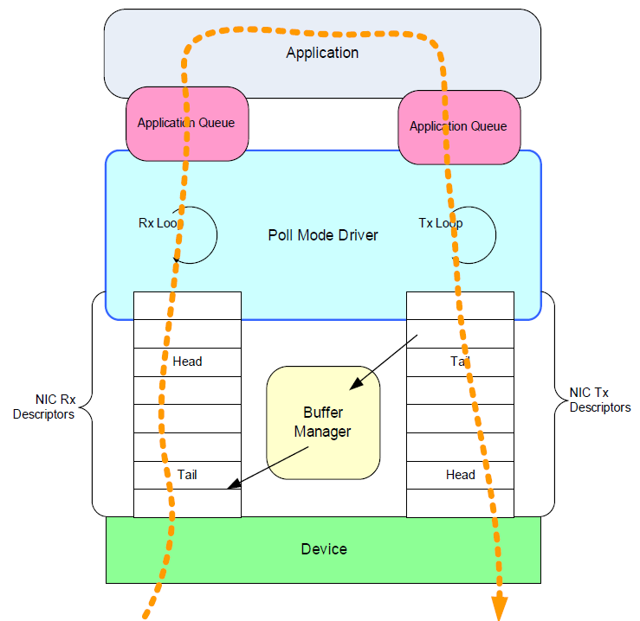
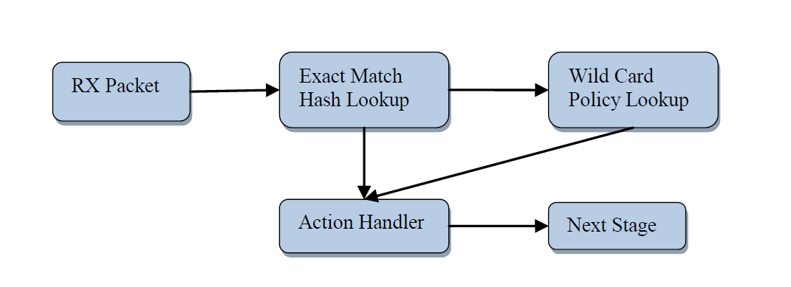
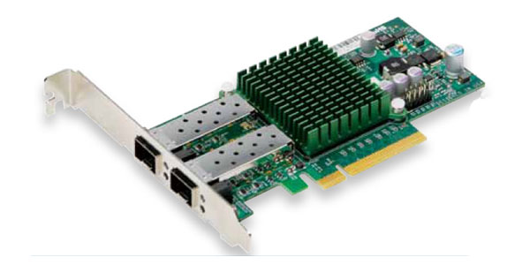
What Is The Task At Hand?
Receive
Process
Transmit
rx cost
tx cost
A Chain is only as strong as …..

Slide 19
Benefits – Eliminating / Hiding Overheads
Eliminating How?
Eliminating /Hiding How?
Interrupt
Context
Switch Overhead
4K Paging Overhead
Polling
Huge Page
Kernel User Overhead
User Mode
Driver
Lockless Inter-core
Communication
Core To Thread Scheduling Overhead
PCI Bridge I/O Overhead
Pthread
Affinity
High Throughput
Bulk Mode I/O calls
To Tackle this challenge, what kind of devices /latency we have at our disposal?

Slide 20
L1 Cache With 4 Cycle Latency
L1 Cache Hit
Core 0
Latency
4 cycle
Read Packet Descriptor
L1 Cache
With 4 cycles Latency, achieving Rx budget of 19 cycles seems within reach.

Slide 21
Challenge: What if there is L1 Cache Miss and LLC Hit?
Core 0
Core 0
How?
L1 Cache
L1 Cache
L1 Cache
Miss
L2 Cache
LLC Cache
40 cycle
Last Level Cache
With 40 cycles LLC Hit, How will you achieve Rx budget of 19 cycles ?

Slide 22
DPDK Trail Blazing - Performance & Functionality
4. Distributed NFV
Platform QoS
Specifying machine to run on
Adapting to the machine
8K Match in h/w, more in s/w
ACL -> NIC
3. Building Block For NFV/OVS
Multiple Pthreads per core
NAPI style Interrupt mode
Cgroups manage resources
MBUF to carry more metadata from NIC
2. Extracting More Instructions Per Cycle
Optimize Code
New /improve Algorithm
Hash Functions – Jhash, rte_hash_crc
Cuckoo Hash
Tune Bulk Operations
Prefetch
1. Packet I/O
Data Direct I/O
AVX1, AVX2
4x10GbE NICs
PCI-E Gen2, Gen 3
First, Let us take a look at Optimizations in Packet I/O

Slide 23
Solution – Amortizing Over Multiple Descriptors
1. Packet I/O
40 ns gets Amortized Over Multiple Descriptors
Roughly getting back to the latency of L1 cache hit per packet
Similarly for packet i/o, Go For Burst Read

Slide 24
Examine Bunch Of Descriptors At A Time
1. Packet I/O
Core 0
Read 8 Packet Descriptors at a time
Packet Descriptor 0
Packet Descriptor 1
L1 Cache
Packet Descriptor 2
Packet Descriptor 3
L2 Cache
Packet Descriptor 4
LLC Cache
40 cycle
Packet Descriptor 5
Last Level Cache
Packet Descriptor 6
Packet Descriptor 7
With 8 Descriptors, 40 ns gets amortized over 8 Descriptors

Slide 25
Design Principle In Packet I/O Optimization
1. Packet I/O
L3fwd default tuning is for performance
  Coalesces packets up to 100 us
  Receives and transmits at least 32 packets at a time
    nb_rx = rte_eth_rx_burst(portid, queueid, pkts_burst, MAX-PKT_BURST)
Could bunch 8,4, 2 (or 1) packets

Slide 26
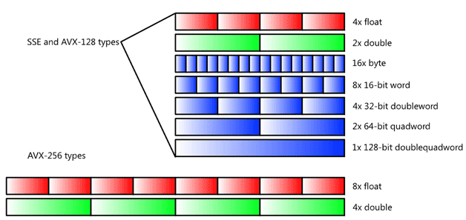
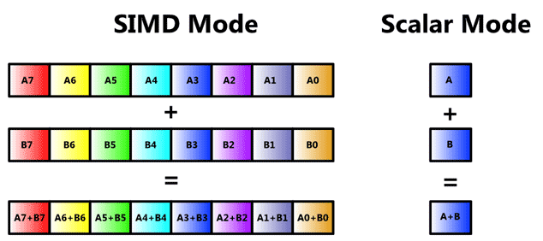
Micro BenchMarks – The Best Kept Secret
1. Packet I/O
Bulk Enqueue /
Bulk Dequeue
Single Producer/
Single Consumer
Different Block sizes
1, 2, 4, 8, 16, 32
SSE – 4 Lookups in Parallel
Next: 2. Extracting More Instructions Per Cycle

Slide 27
2. Extracting More Instructions Per Cycle
How Can Your NFV Application Benefit From SSE and AVX ?
ACL
Classify

Slide 28
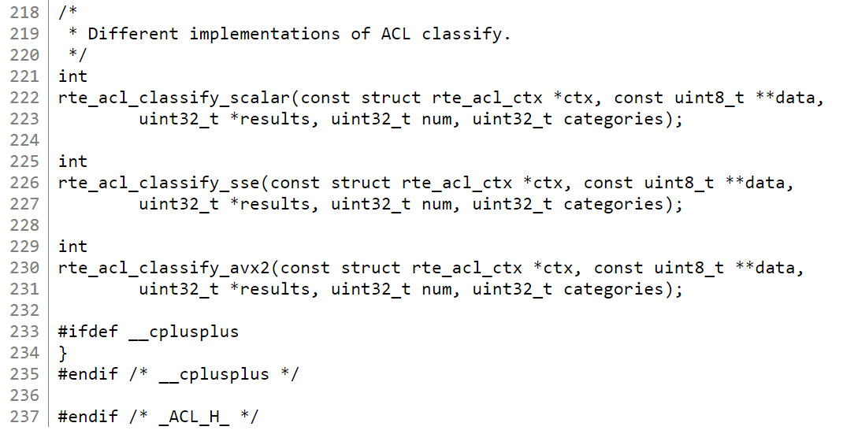
Exploiting Data Parallelism
2. Extracting More Instructions Per Cycle
ACL
Classify

Slide 29
2. Extracting More Instructions Per Cycle
What About Exact Match Lookup Optimization?

Slide 30
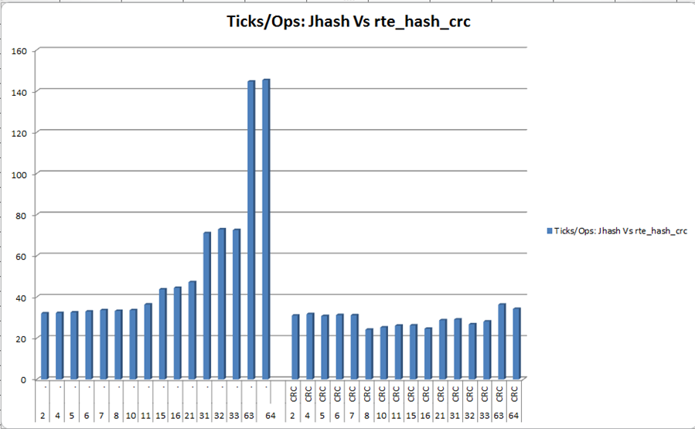
Comparison of Different Hash Implementations
2. Extracting More Instructions Per Cycle
Configuration:
intel® CoreTM i7 – 2 sockets
Frequency – 3 GHz
Memory: 2 Meg Huge Page –
2 Gig each socket
82599 10 Gig NIC
Faster Hash Functions
Higher Flow Count (16M, 32M Flows)
1 Billion Entries? Bring it on !! - DPDK & Cuckoo Switch

Slide 31
Trail Blazing - Performance & Functionality
4. Distributed NFV
Platform QoS
Specifying machine to run on
Adapting to the machine
8K Match in h/w, more in s/w
ACL -> NIC
3. Building Block For NFV/OVS
Multiple Pthreads per core
NAPI style Interrupt mode
Cgroups manage resources
MBUF to carry more metadata from NIC
2. Extracting More Instructions Per Cycle
Optimize Code
New /improve Algorithm
Hash Functions – Jhash, rte_hash_crc
Cuckoo Hash
Tune Bulk Operations
Prefetch
1. Packet I/O
Data Direct I/O
AVX1, AVX2
4x10GbE NICs
PCI-E Gen2, Gen 3

Slide 32
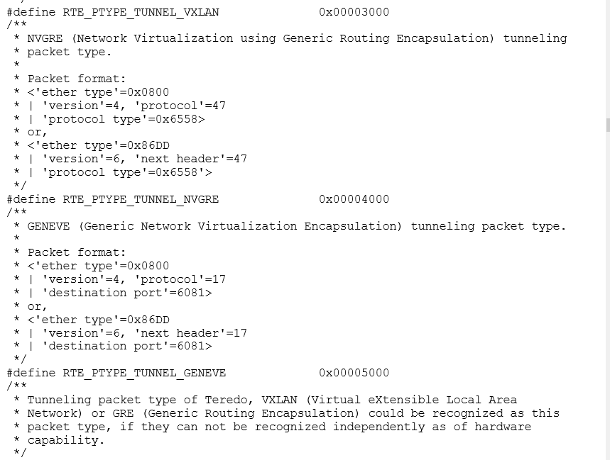
Mbuf To Carry More Metadata From NIC
3. Building Block For NFV/OVS
http://www.dpdk.org/browse/dpdk/tree/lib/librte_mbuf/rte_mbuf.h

Slide 33
What DPDK Features To Enhance NFV ?
4. Distributed NFV
What About Specifying Which Machine (with capabilities) to Run on?
If not available, how about adapting to the Machine where NFV was placed?
What About …
To Know More Register For Free in www.dpdk.org community

Slide 34
Summary
DPDK offers the best performance for packet processing.
OVS Netdev-DPDK is progressing with new features and performance enhancements.
Ready for deployments today.

Slide 35
System Settings
System Capability | Configuration
DPDK Compilation | CONFIG_RTE_BUILD_COMBINE_LIBS=y CONFIG_RTE_LIBRTE_VHOST=y CONFIG_RTE_LIBRTE_VHOST_USER=y DPDK compiled with "-Ofast -g"
OVS Compilation | OVS configured and compiled as follows: #./configure --with-dpdk=<DPDK SDK PATH>/x86_64-native-linuxapp \ CFLAGS="-Ofast -g" make CFLAGS="-Ofast -g -march=native"
DPDK Forwarding Applications | Build L3fwd: (in l3fwd/main.c) #define RTE_TEST_RX_DESC_DEFAULT 2048 #define RTE_TEST_TX_DESC_DEFAULT 2048 Build L2fwd: (in l2fwd/main.c) #define NB_MBUF 16384 #define RTE_TEST_RX_DESC_DEFAULT 2048 #define RTE_TEST_TX_DESC_DEFAULT 2048 Build testpmd: (in test-pmd/testpmd.c) #define RTE_TEST_RX_DESC_DEFAULT 2048 #define RTE_TEST_TX_DESC_DEFAULT 2048
System Capability | Version
Host Operating System | Fedora 21 x86_64 (Server version) Kernel version: 3.17.4-301.fc21.x86_64
VM Operating System | Fedora 21 (Server version) Kernel version: 3.17.4-301.fc21.x86_64
libvirt | libvirt-1.2.9.3-2.fc21.x86_64
QEMU | QEMU-KVM version 2.2.1 http://wiki.qemu-project.org/download/qemu-2.2.1.tar.bz2
DPDK | DPDK 2.0.0 http://www.dpdk.org/browse/dpdk/snapshot/dpdk-2.0.0.tar.gz
OVS with DPDK-netdev | Open vSwitch 2.4.0 http://openvswitch.org/releases/openvswitch-2.4.0.tar.gz
System Capability | Description
Host Boot Settings | HugePage size = 1 G; no. of HugePages = 16 HugePage size = 2 MB; no. of HugePages = 2048 intel_iommu=off Hyper-threading disabled: isolcpus = 1-13,15-27 Hyper-threading enabled: isolcpus = 1-13,15-27,29-41,43-55
VM Kernel Boot Parameters | GRUB_CMDLINE_LINUX="rd.lvm.lv=fedora-server/root rd.lvm.lv=fedora-server/swap default_hugepagesz=1G hugepagesz=1G hugepages=1 hugepagesz=2M hugepages=1024 isolcpus=1,2 rhgb quiet"

Slide 36
System Settings
System Capability | Settings
Linux OS Services Settings | # systemctl disable NetworkManager.service # chkconfig network on # systemctl restart network.service # systemctl stop NetworkManager.service # systemctl stop firewalld.service # systemctl disable firewalld.service # systemctl stop irqbalance.service # killall irqbalance # systemctl disable irqbalance.service # service iptables stop # echo 0 > /proc/sys/kernel/randomize_va_space # SELinux disabled # net.ipv4.ip_forward=0
Uncore Frequency Settings | Set the uncore frequency to the max ratio.
PCI Settings | # setpci –s 00:03.0 184.l 0000000 # setpci –s 00:03.2 184.l 0000000 # setpci –s 00:03.0 184.l=0x1408 # setpci –s 00:03.2 184.l=0x1408
Linux Module Settings | # rmmod ipmi_msghandler # rmmod ipmi_si # rmmod ipmi_devintf

Slide 37
Thank YOU For Painting The NFV World With DPDK
Register in DPDK Community - http://dpdk.org/ml/listinfo/dev
  Collaborate with Intel in Open Source and Standard Bodies.
  DPDK, Virtual Switch, Open DayLight, Open Stack etc.
2. Develop applications with DPDK for a Programmable & Scalable VNF
3. Evaluate Intel Open Network Platform for best-in-class NFVi
  Download from 01.org & evaluate
  Become familiar with data plane benchmarks on Intel® Xeon platforms
Let’s Collaborate and Accelerate NFV Deployments

